Slide 1

Game Inventory System
Thanks Obama
Steven Rhodes

Slide 2
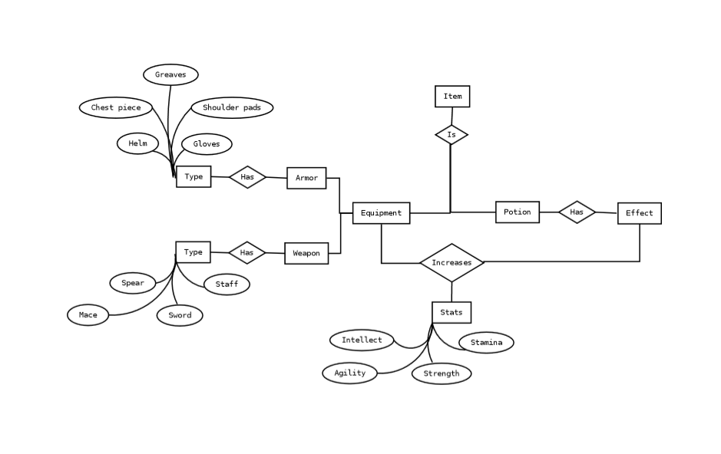
Initial Plan
Develop an inventory system such as those commonly used in video games
Allows the player to arrange, compare, add, and drop items from their inventory. Typically, the inventory is a carried cache or backpack, a storage repository
The developer can create new items easily, or the game can randomly generate items based on item templates
Conceptual Design

Slide 3
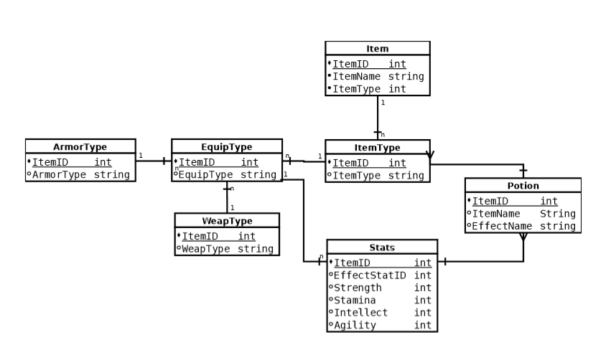
Inventory Objects
Objects in the inventory will reference data in a database.
The database will contain statistics such as armor, strength, intelligence, and weight of the object.
This data will be referenced by the corresponding graphical object with which the users interacts.
Logical Design

Slide 4
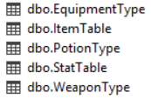
Database Implementation
Example test item table
Selection of database product – Microsoft SQL Server
Utilized MSSMS to attempt to create normalized tables (this is hard)
Resulted in the following schema:
Item ID | Item Name | Item Type | Equip Slot | Strength | Stamina | Agility | Intellect | Wisdom
1 | Charle’s Progressive Chainmail | EquipType | Chest | 11 | 9 | 9 | 15 | 12
2 | Deniqtrius’ Deathaxe of Democracy | EquipType | Main Hand | 14 | 20 | 9 | 12 | 0
3 | Sam’s Sarong of Gun Control | EquipType | Legs | 9 | 9 | 18 | 13 | 11
4 | Robert’s Elixir of Mispronunciation | PotionType | Null | 12 | 8 | 11 | 14 | 15
5 | The Ryanizer – “Are you familiar with. . .” | Equiptype | Main Hand | 10 | 11 | 9 | 18 | 18
6 | Oscars’ Vertical Advantage | PotionType | Null | 14 | 14 | 15 | 15 | 13
7 | Thomas’ Lawyerly Draught | PotionType | Null | 9 | 21 | 23 | 17 | 15

Slide 5
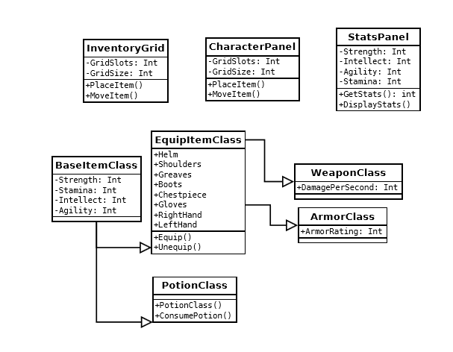
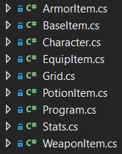
Implementation and Class Structure
Wow. Software development is easy.

Slide 6

Implementation and Class Structure
Wow. Software development is easy.

Slide 7
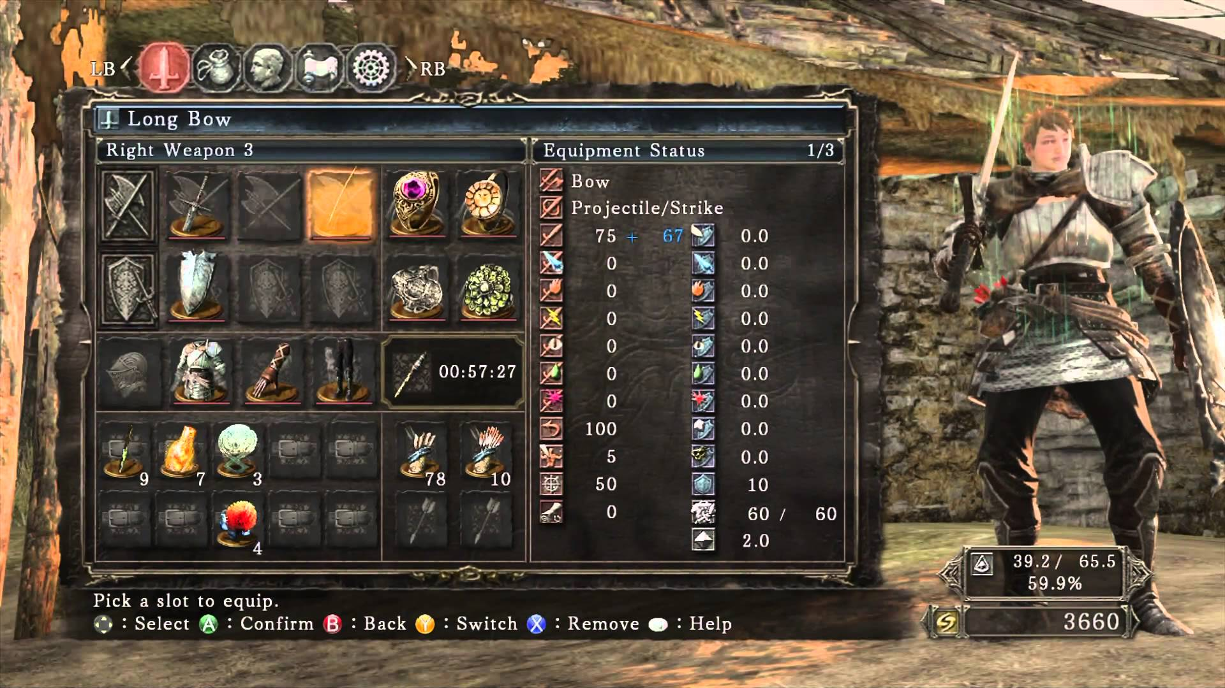
Desired Outcome

Slide 8
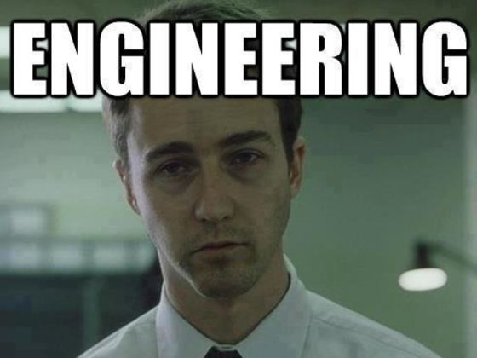
Actual Outcome
Software
Next, I’ll present a fully realized system

